Slide 1
From Analysis to Action:
Driving Business Value Through Insights into Today’s Labor Market
October 2024
Presented by
Alex Chausovsky

Slide 2
Our Talk Today
Topics We'll Cover
Labor Market Update
Attracting Top Candidates
Hiring Strategies
Talent Retention
Best Practices

Slide 3
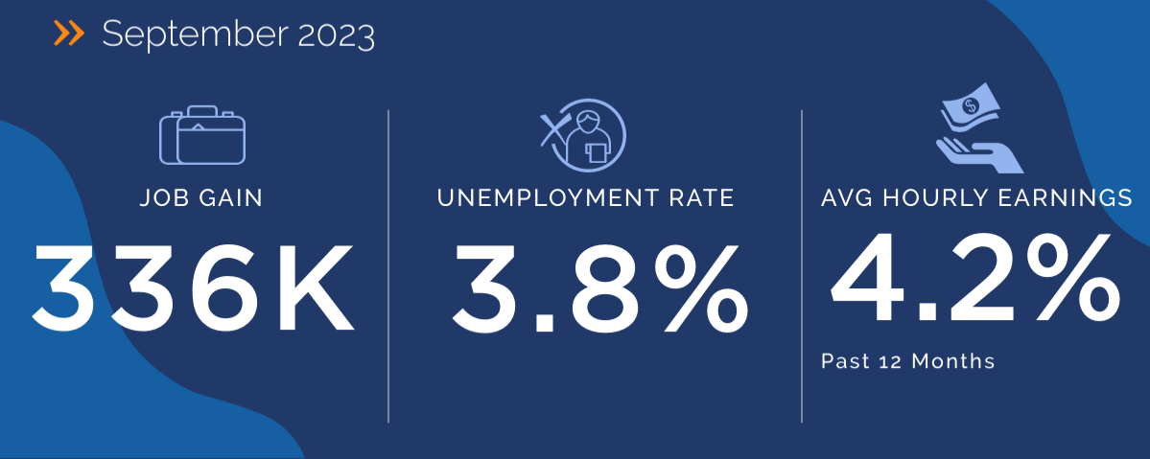
National Labor Market Performance
January 2025
143K
4.0%
4.1%
Past 12 Months
Source: Bureau of Labor Statistics | Bundy Group

Slide 4
Jobs Added by Sector – January 2025
Education and health services | 61K
Retail trade | 34K
Government | 32K
Construction | 4K
Manufacturing | 3K
Distribution | 2K
Transportation & Warehousing | 1K
Leisure & Hospitality | -3K
Professional & Business Services | -11K
1.75M (80%) of the 2.2M jobs added in 2024 were in the
healthcare, government, and leisure & hospitality sectors
Putting it in context….
Construction added <200K jobs
Professional and business services lost 60K jobs
while Manufacturing lost 100K jobs in 2024
Source: Bureau of Labor Statistics | Bundy Group

Slide 5
Talent Availability - Details Matter
4.0%
Legal | 1.2%
Healthcare Practitioners | 1.4%
Management | 1.9%
Architecture & Engineering | 1.2%
Financial Operations | 2.6%
Sales | 4.9%
National Unemployment Rate
January 2025
Market Supply
Significant Shortage
Significant Surplus
Source: Bureau of Labor Statistics | LaborIQ | Bundy Group

Slide 6
The Labor Gap is Gone
Prominent Sectors
1.6M Education & Healthcare
1.6M Professional & Business
1.1M Leisure & Hospitality
880K Government - DOGE
553K Retail Trade
428K Manufacturing
217K Construction
157K Wholesale Trade
7.6M
7.5M
Source: Bureau of Labor Statistics | Bundy Group

Slide 7
Hiring has Slowed Noticeably
2020 rebound:
15M+
2000 – 2019 average: 4.97M
2018/19 level
Source: Bureau of Labor Statistics | Bundy Group

Slide 8
No Concerning Increase in Layoffs
2020 surge:
22M+
2008/09 surge:
12M+
At 2019 levels
Source: Bureau of Labor Statistics | Bundy Group

Slide 9
Quits are Below Pre-Covid Level
2021/2022 surge:
4.5M+
2000 – 2019 average: 2.642M
2018/19 level
Source: Bureau of Labor Statistics | Bundy Group

Slide 10
Do you have a Talent Strategy?
Yes, absolutely! Who doesn't?
27%
This is a clear call to action for many businesses!
No, but we're working on one!
64%
No, we're fine without one.
9%
Source: Bundy Group

Slide 11
Attracting the Top Talent
WHAT CAN YOUR ORGANIZATION DO TO STAND APART?

Slide 12
Factors of Consideration
Your Leadership
Your Strategy
Your Culture
Your Comp & Benefits
Your Management Team
Your Vision
Your Mission
Your Values
Your Market
Your Product

Slide 13
MARKET
Markets are not monolithic.
PRODUCT
Explain why your offering is positioned to take advantage of growth?
FOUR PILLARS
TEAM
Attracting Talent as a Marketing Function
Who are the Key Players and what have they accomplished?
MISSION
What is the company trying to accomplish beyond making money?
Source: MRI Network | Bundy Group

Slide 14
CHALLENGE
The work itself, technology, market, ect.
LOCATION
Geography, ability to live & Work where you want.
ADVANCEMENT
CLAMPS
Career growth, increasing responsibility.
A vital part of the conversation with candidates
MONEY
Overall Compensation
PEOPLE
Your manager and coworkers
SECURITY
Likelihood of long-term employment
Source: MRI Network | Bundy Group

Slide 15
Hiring Best Practices
IMPROVING EFFICIENCY AND EFFECTIVENESS OF YOUR ORGANIZATION'S HIRING PRACTICES

Slide 16
Recruitment & Hiring
Training & Development
Employer-Employee Relations
Maintain Company Culture
HR DUTIES
Manage Employee Benefits
Handle Disciplinary Actions
Create a Safe Work Environment

Slide 17
Active Candidates
Passive Candidates
Unemployed
Proactively searching
Set up job alerts
Actively applying (Shotgun approach)
VS
Employed
Not searching but open
Casually browsing
Wouldn't apply unless personally engaged
Source: MRI Network | Bundy Group

Slide 18
The Type of Candidates You Interview is Critical
It takes ~11 interviews to fill a role with active candidates
It takes ~4 interviews to fill a role with passive candidates
Continuous Improvement is the goal
Source: MRI Network | Bundy Group

Slide 19
How Many Interviews Should it Take?
1-2 Interviews
83%
3-5 Interviews
14%
If your process involves conducting more than 2 interviews to fill a job opening, you could miss out on top talent!
6+ Interviews
2%
Other
1%
Source: Bundy Group

Slide 20
APPLICANTS PER HIRE
The number of people who have applied to a role
TIME TO FILL
The amount of time it takes to find a new candidate
Hiring Metrics to Consider
INTERVIEW TO OFFER
How many interviews it takes to find an offer-worthy candidate
OFFER ACCEPTANCE RATE
The percentage of extended offers accepted
COST PER HIRE
Total monetary and time investment required to fill the role
PROFITABILITY PER ADDITIONAL EMPLOYEE
How much additional profit this position represents
Source: MRI Network | Bundy Group

Slide 21
Retaining Impact Players
MOVING THE NEEDLE WHEN IT COMES TO IMPROVING ENGAGEMENT AND RETENTION

Slide 22
PAY AND BENEFITS ARE NOT COMPETITIVE
THE IMMEDIATE MANAGER
POOR COMPANY CULTURE
IMPROPER FIT TO THE JOB
COWORKERS NOT COMMITTED TO QUALITY WORK
Top 5 Predictors of Turnover
Source: Gallup Research | Bundy Group

Slide 23
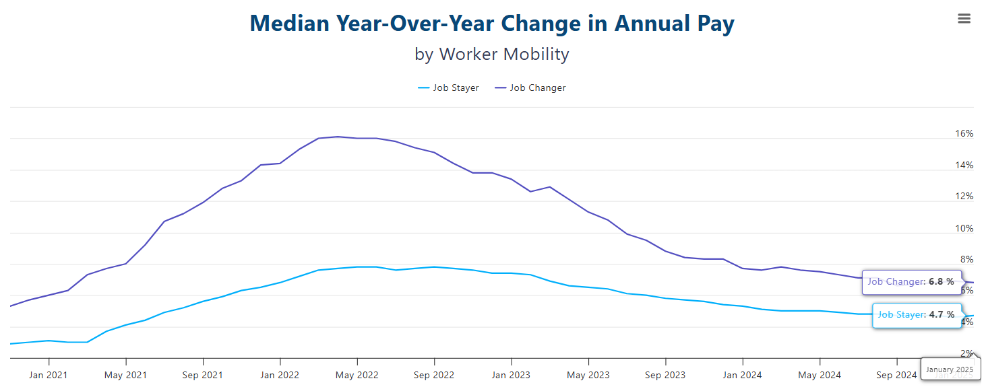
New Hire Wage Premium Still Exists
Source: ADP Research | Bundy Group

Slide 24
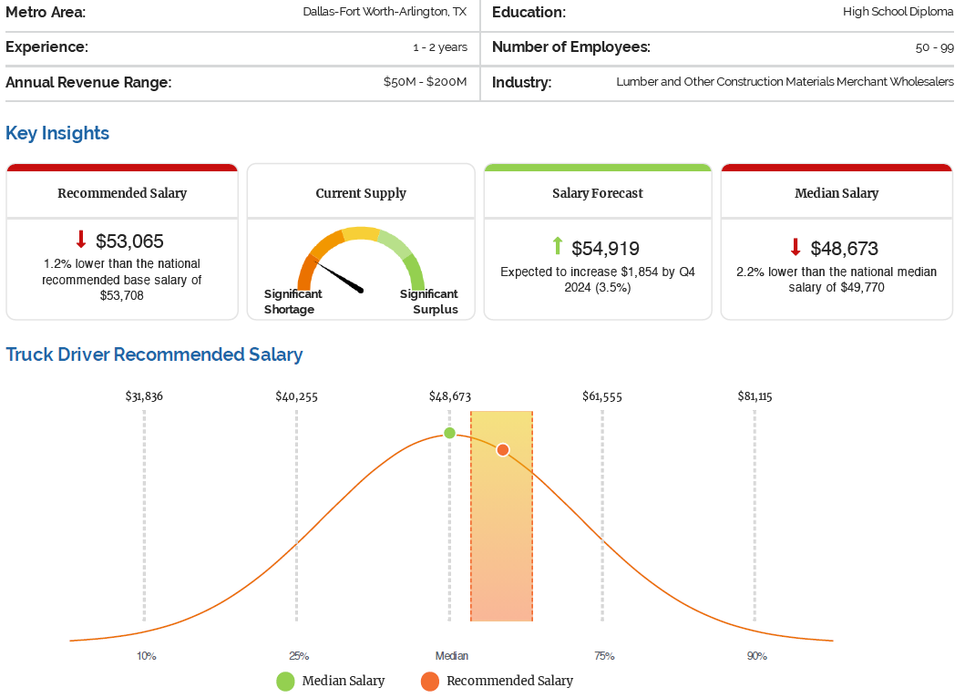
Compensation Analysis

Slide 25
A Comprehensive Offer
LEVERS TO PULL
Salary
Bonus
LTI's
Sign-on's
WFX
PTO
Relocation Packages
Options, RSU's
arrangements
Source: MRI Network | Bundy Group

Slide 26
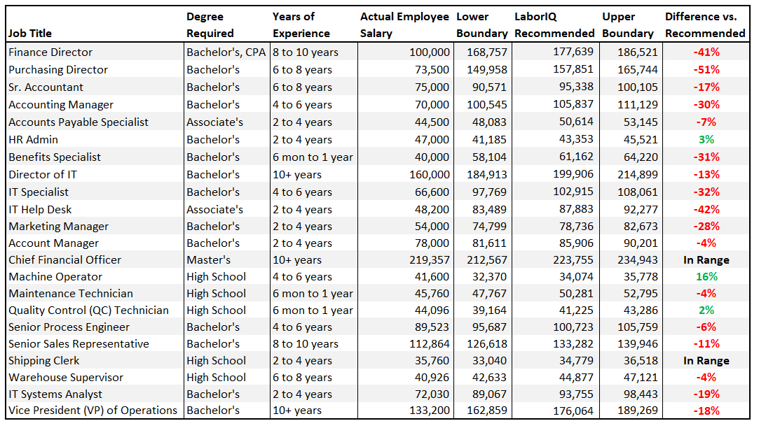
Are your current employees
getting paid what they’re worth?

Slide 27
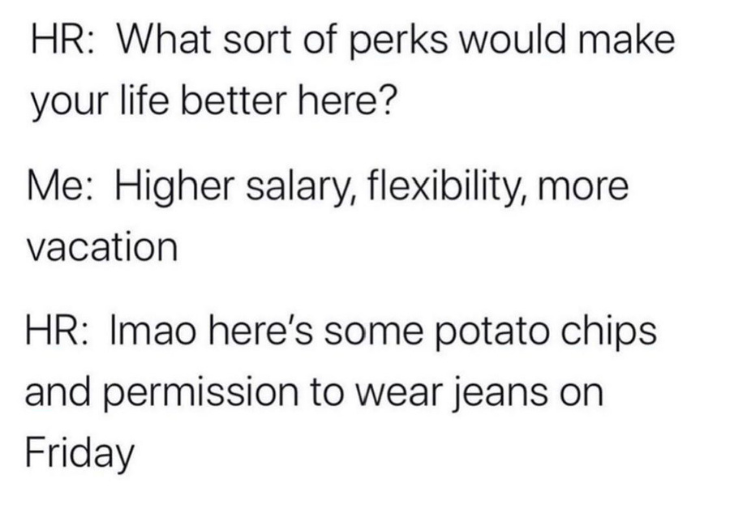
Post-Pandemic Job Market Requires Focus on Retention
Old Approach
New Approach
TM
Gallup Q12
Engagement Hierarchy
How can we grow?
Growth
Do I belong?
Teamwork
VS
Management Support
What do I give?
What do I get?
Basic Needs

Slide 28
Key Retention Gauges:
I HAVE THE OPPORTUNITY TO DO WHAT I DO BEST EVER DAY.
MY FELLOW EMPLOYEES ARE COMMITTED TO DOING QUALITY WORK.
I KNOW WHAT IS EXPECTED OF ME AT WORK.
AT WORK, MY OPINIONS SEEM TO COUNT.
POTENTIAL FOR A 23% REDUCTION IN TURNOVER
POTENTIAL FOR A 30% REDUCTION IN TURNOVER
POTENTIAL FOR A 21% REDUCTION IN TURNOVER
POTENTIAL FOR A 31% REDUCTION IN TURNOVER
Source: Q12 Survey

Slide 29
EMPLOYEE RETENTION RATE
The number of employees who have stayed within a given period
EMPLOYEE TURNOVER RATE
RetentionMetrics to Track
The number of workers that must be replaced within a given period
VOLUNTARY TURNOVER RATE
The turnover rate for staff who choose to leave
EMPLOYEE TURNOVER COST
The amount it takes to bring in a replacement employee
EMPLOYEE TENURE
The average amount of time employees stay at your company

Slide 30
Key Takeaways
ACTIONABLE AND PRACTICAL ADVICE FOR CONTINUOUS TALENT STRATEGY IMPROVEMENT

Slide 31
Allocate resources to developing and continuously improving a comprehensive talent strategy
Be a data-driven decision-maker
Find partners and allies
Communicate why your company is attractive and understand candidate priorities
Strive for efficiency and top-notch communication in the hiring process
Competitive pay is key; also, ask for input, listen, and respond to keep your people
Developing an Effective Talent Strategy Requires Commitment

Slide 32
CONNECT WITH ALEX ON LINKEDIN
Q&A
ALEX@BUNDYGROUP.COM
512-743-9017
BUNDYGROUP.COM
February 2025
Presented by
Alex Chausovsky

