Slide 1

Tom Rugg, Briggs & Stratton
February 24, 2025
©2025 Briggs & Stratton. Proprietary and Confidential.
Notes:
On the screen as people enter

Slide 2

INTRODUCTION
Tom Rugg
Senior Vice President and
President, Power & Energy Solutions
Briggs & Stratton, LLC

Slide 3
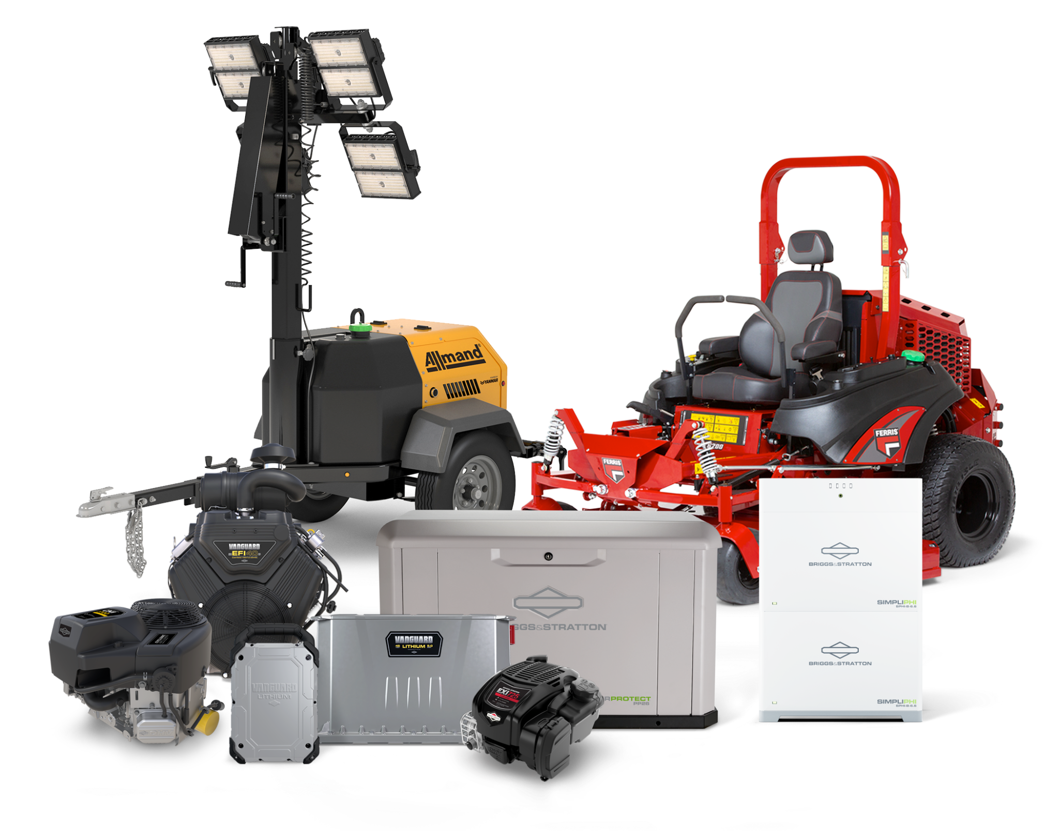
COMPANY OVERVIEW
A family of brands and a broad portfolio of products.
POWER
Residential, Commercial and Utility Engines, Service Parts
ELECTRIFICATION
Lithium-Ion Battery Packs, Motors & Controllers, Chargers
TURF & CONSUMER
Residential & Commercial Mowers and Turf Care, Service & Support
JOB SITE
Light Towers, Portable Heaters, Portable Generators
ENERGY SOLUTIONS
Standby Generators, Battery Storage Systems, Transfer Switches

Slide 4



INDUSTRY UPDATE
Industry Themes
MARKET DYNAMICS
TECHNOLOGY
REGULATORY CHANGES

Slide 5

©2025 Briggs & Stratton. Proprietary and Confidential.
Notes:
On the screen as people enter

Slide 6
















MARKET DYNAMICS
Industry players are changing.
Key Takeaways
Consolidation and equity stakes are increasingly common for economy of scale, diversification and purchasing power
Implications for others
  Unique value becomes
  more critical
  Maintain focus on customer needs
  Servicing your existing customer base is critical
MFGR
• Moore • Acres Group
TURF PRO
• Summit • Smiths Tree • Apex Land

Slide 7
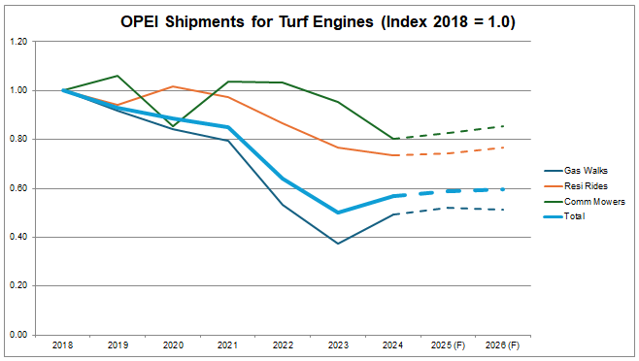
MARKET DYNAMICS
Volatility is starting to normalize.
Key Takeaways
Pandemic boom and bust at the center of market volatility; resuting in high channel inventory
Commercial Turf market poised for a rebound in 2025 due to 4 year replacement cycle
Interest rates continue to pressure small businesses slowing investment/ replacement mowers

Slide 8
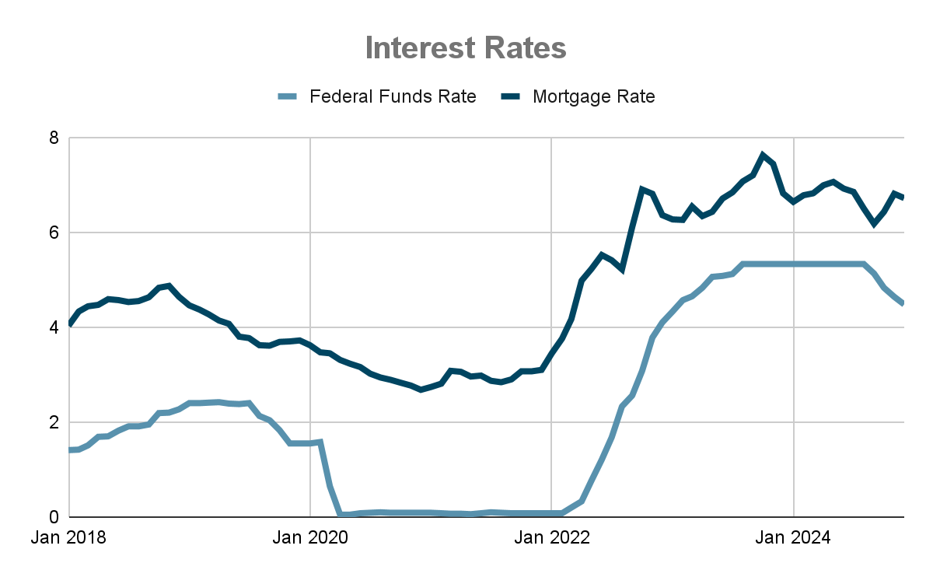
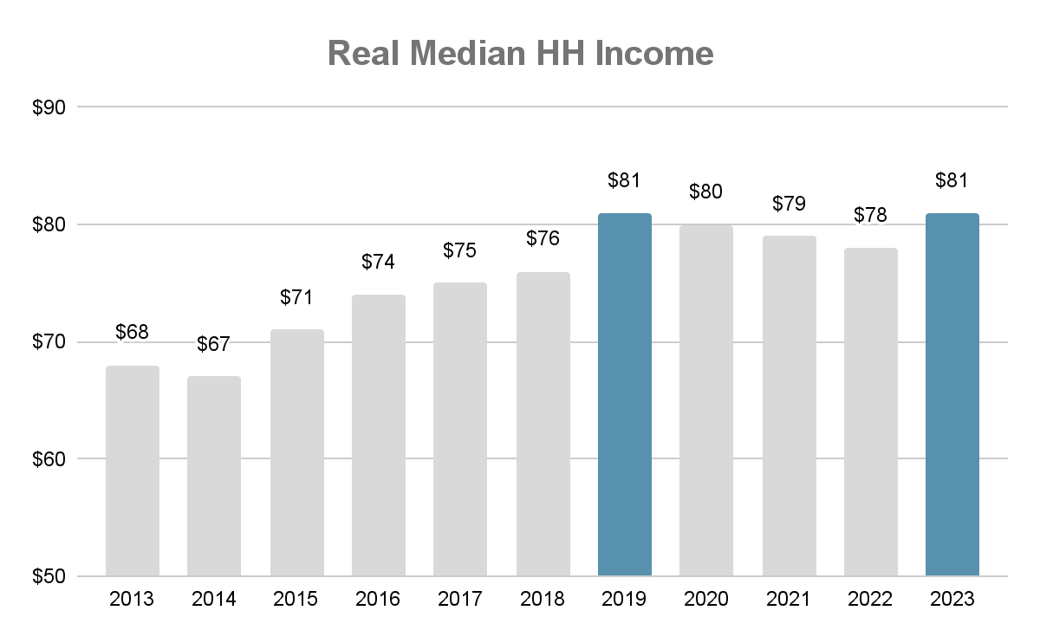
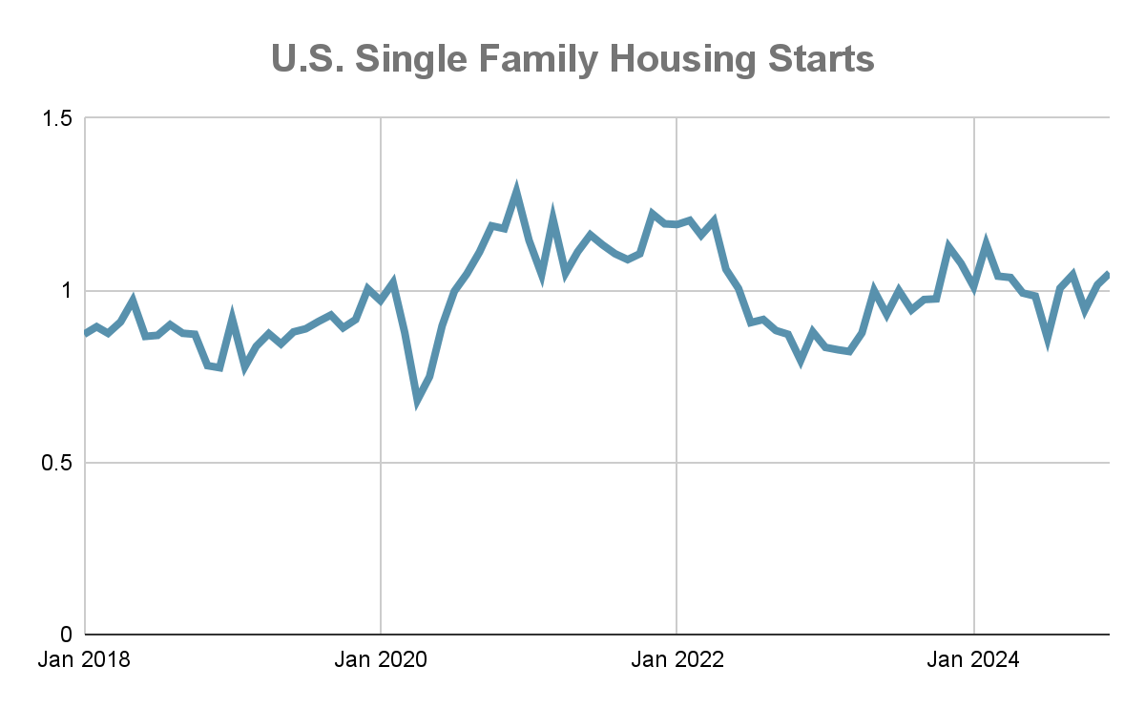
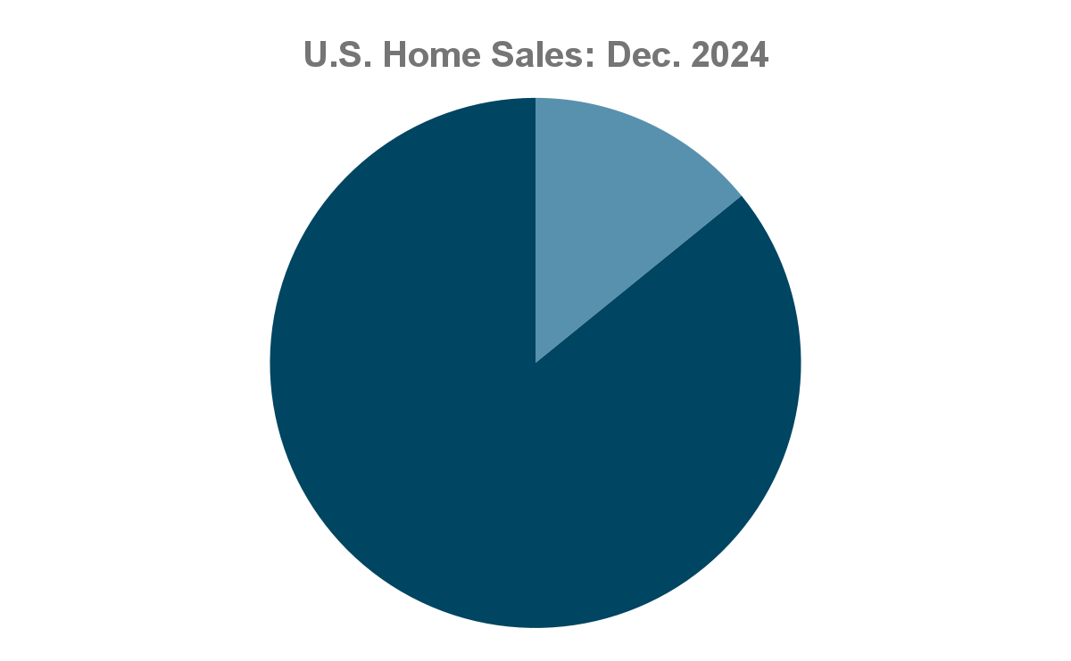
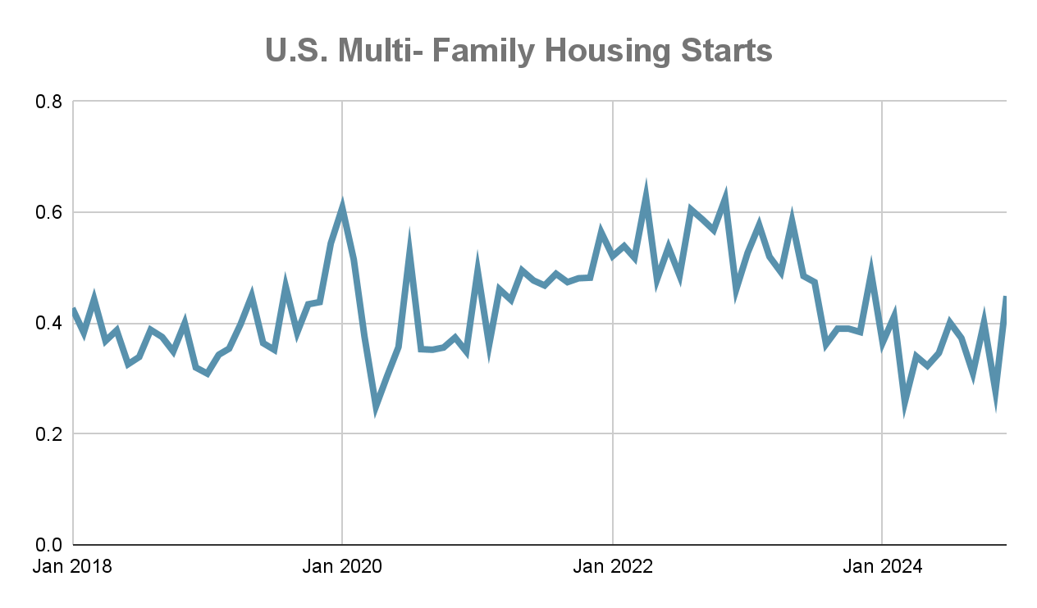
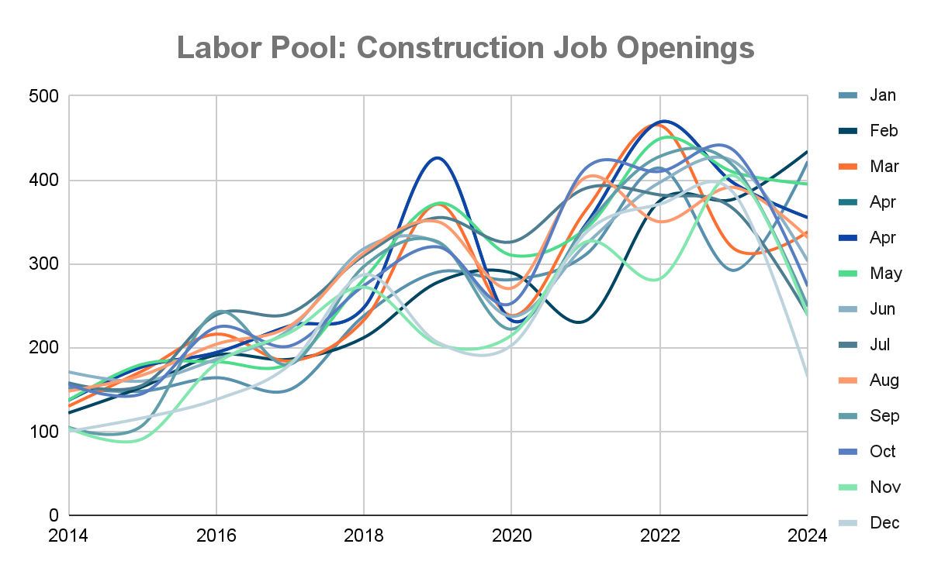
MACRO ECONOMIC FORCES
Key Takeaways
RESIDENTIAL
Demand highly correlated with existing home sales
Mortgage rates will likely stay elevated for longer; potentially impacting new home starts
HH Income increasing; potential for more home buyers
COMMERCIAL
Multi-Family housing is stagnant
Turf Labor Pool is under pressure from Construction Labor Pool
ECONOMIC
NEW
14%
RESIDENTIAL
EXISTING
86%
COMMERCIAL

Slide 9
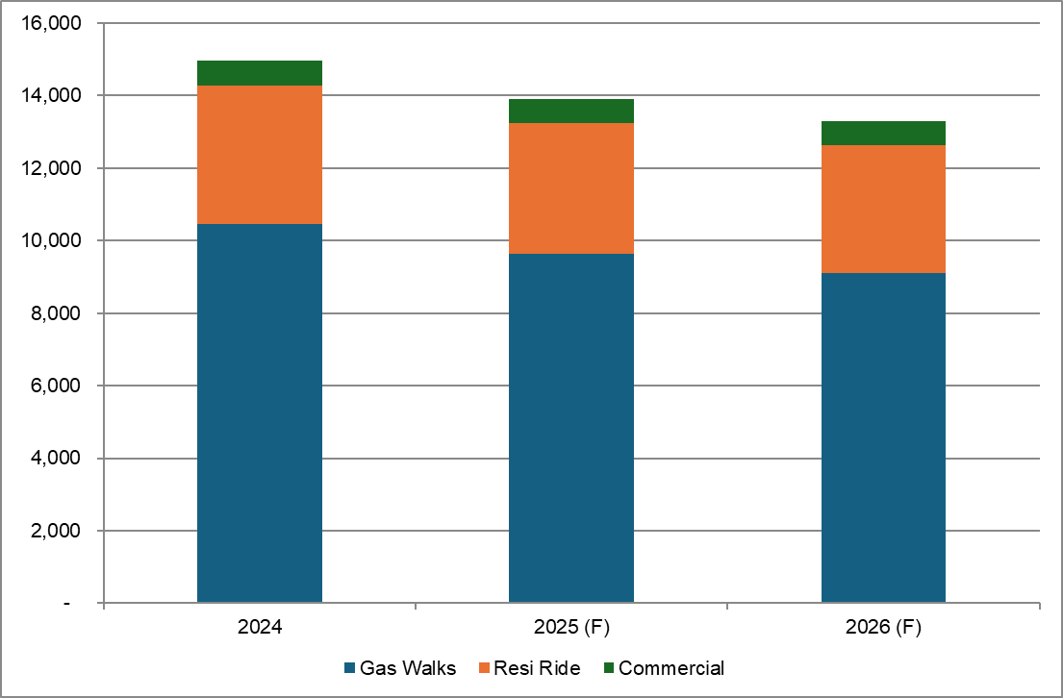
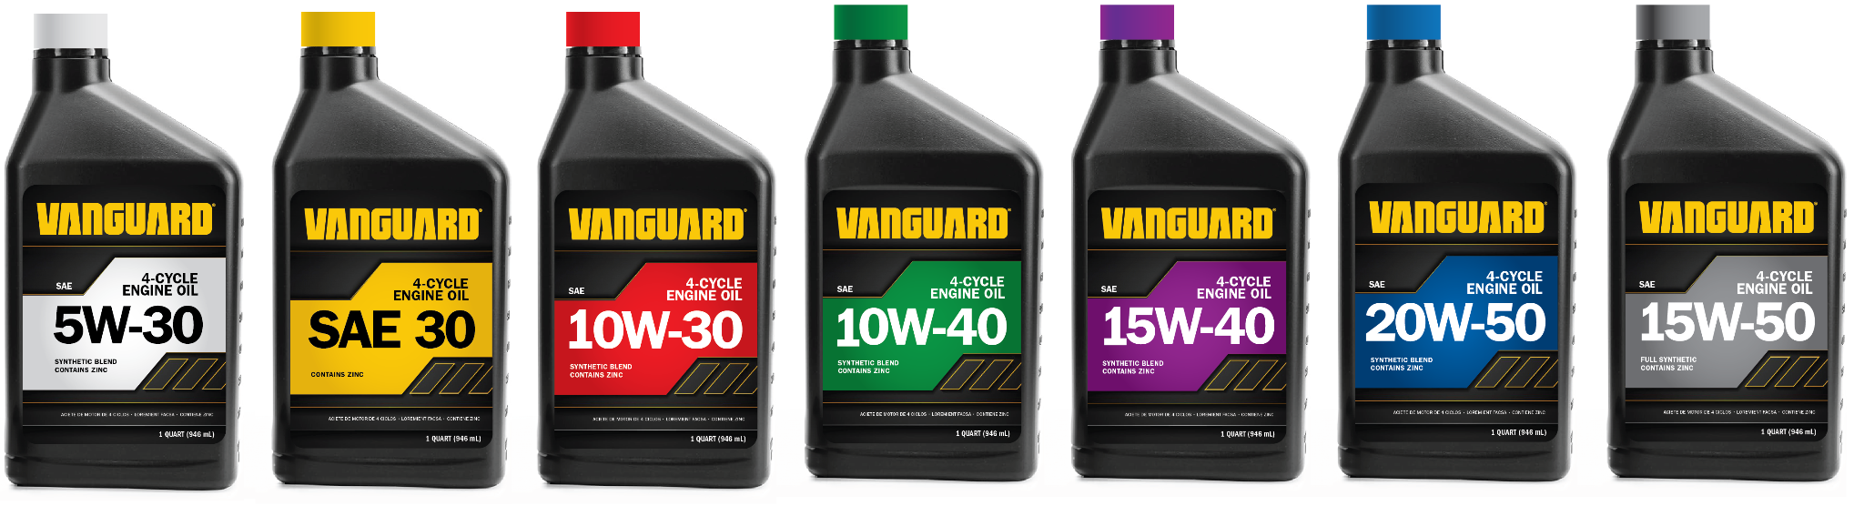
MARKET DYNAMICS
Installed market for service remains huge.
Key Takeaways
Installed Engine market remains high >12M engines led by residential walk
Briggs alone has ~10 million installed engines
Long tail of service requirements will continue to underpin industry profitability
2024 OPEI Annual Shipments with Forecast
NEW Vanguard Full-Line Oils
Service Life Applied: Gas Walk (7yrs), Resi Ride (5yrs), Commercial (4yrs)

Slide 10

©2025 Briggs & Stratton. Proprietary and Confidential.
Notes:
On the screen as people enter

Slide 11
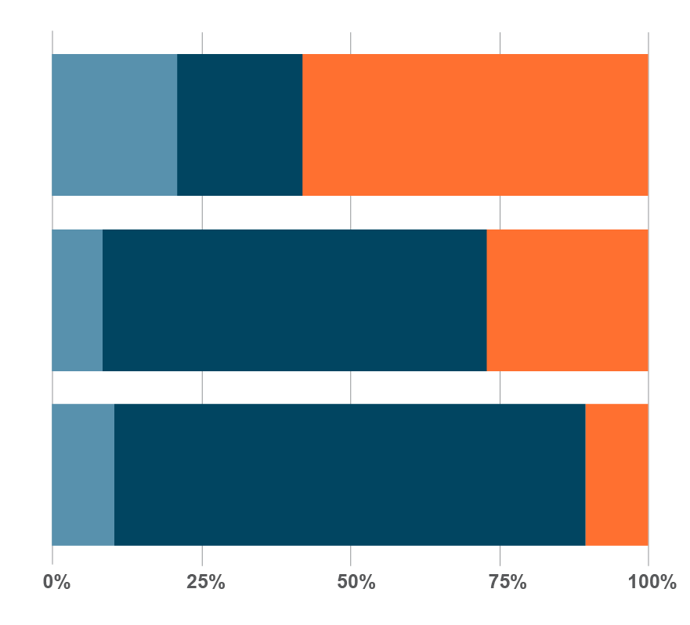
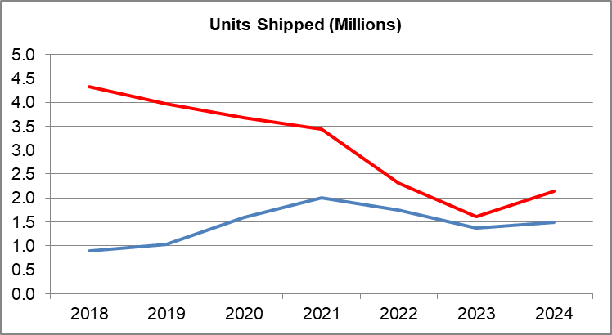
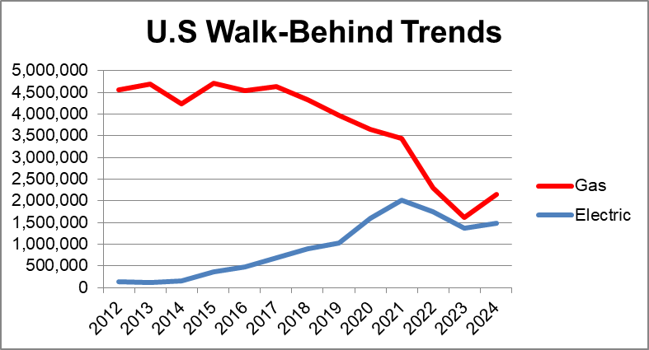
TECHNOLOGY
Battery power will grow but adoption has slowed in some segments.
Key Takeaways
Battery is most prevalent in handheld and has established a ~45% share position in gas powered mowers
Research shows consumer frustration with battery grows over time resulting in gas gaining share in 2024
Less than 1% of other Turf categories powered by battery
Major obstacles related to product performance, cost and return on investment have slowed anticipated adoption of Battery
U.S. Walk-Behind Trends
Battery Mower Owners
<1 Yr
WHY?
2 Yr
5 Yr
Gas
Advocates
Neutral
Battery Advocates
Longer experience with battery
results in lower satisfaction
Source: Walk Shipments: OPEI. Battery Satisfaction: B&S Battery Mower Customer Sentiment Survey May 2024.

Slide 12
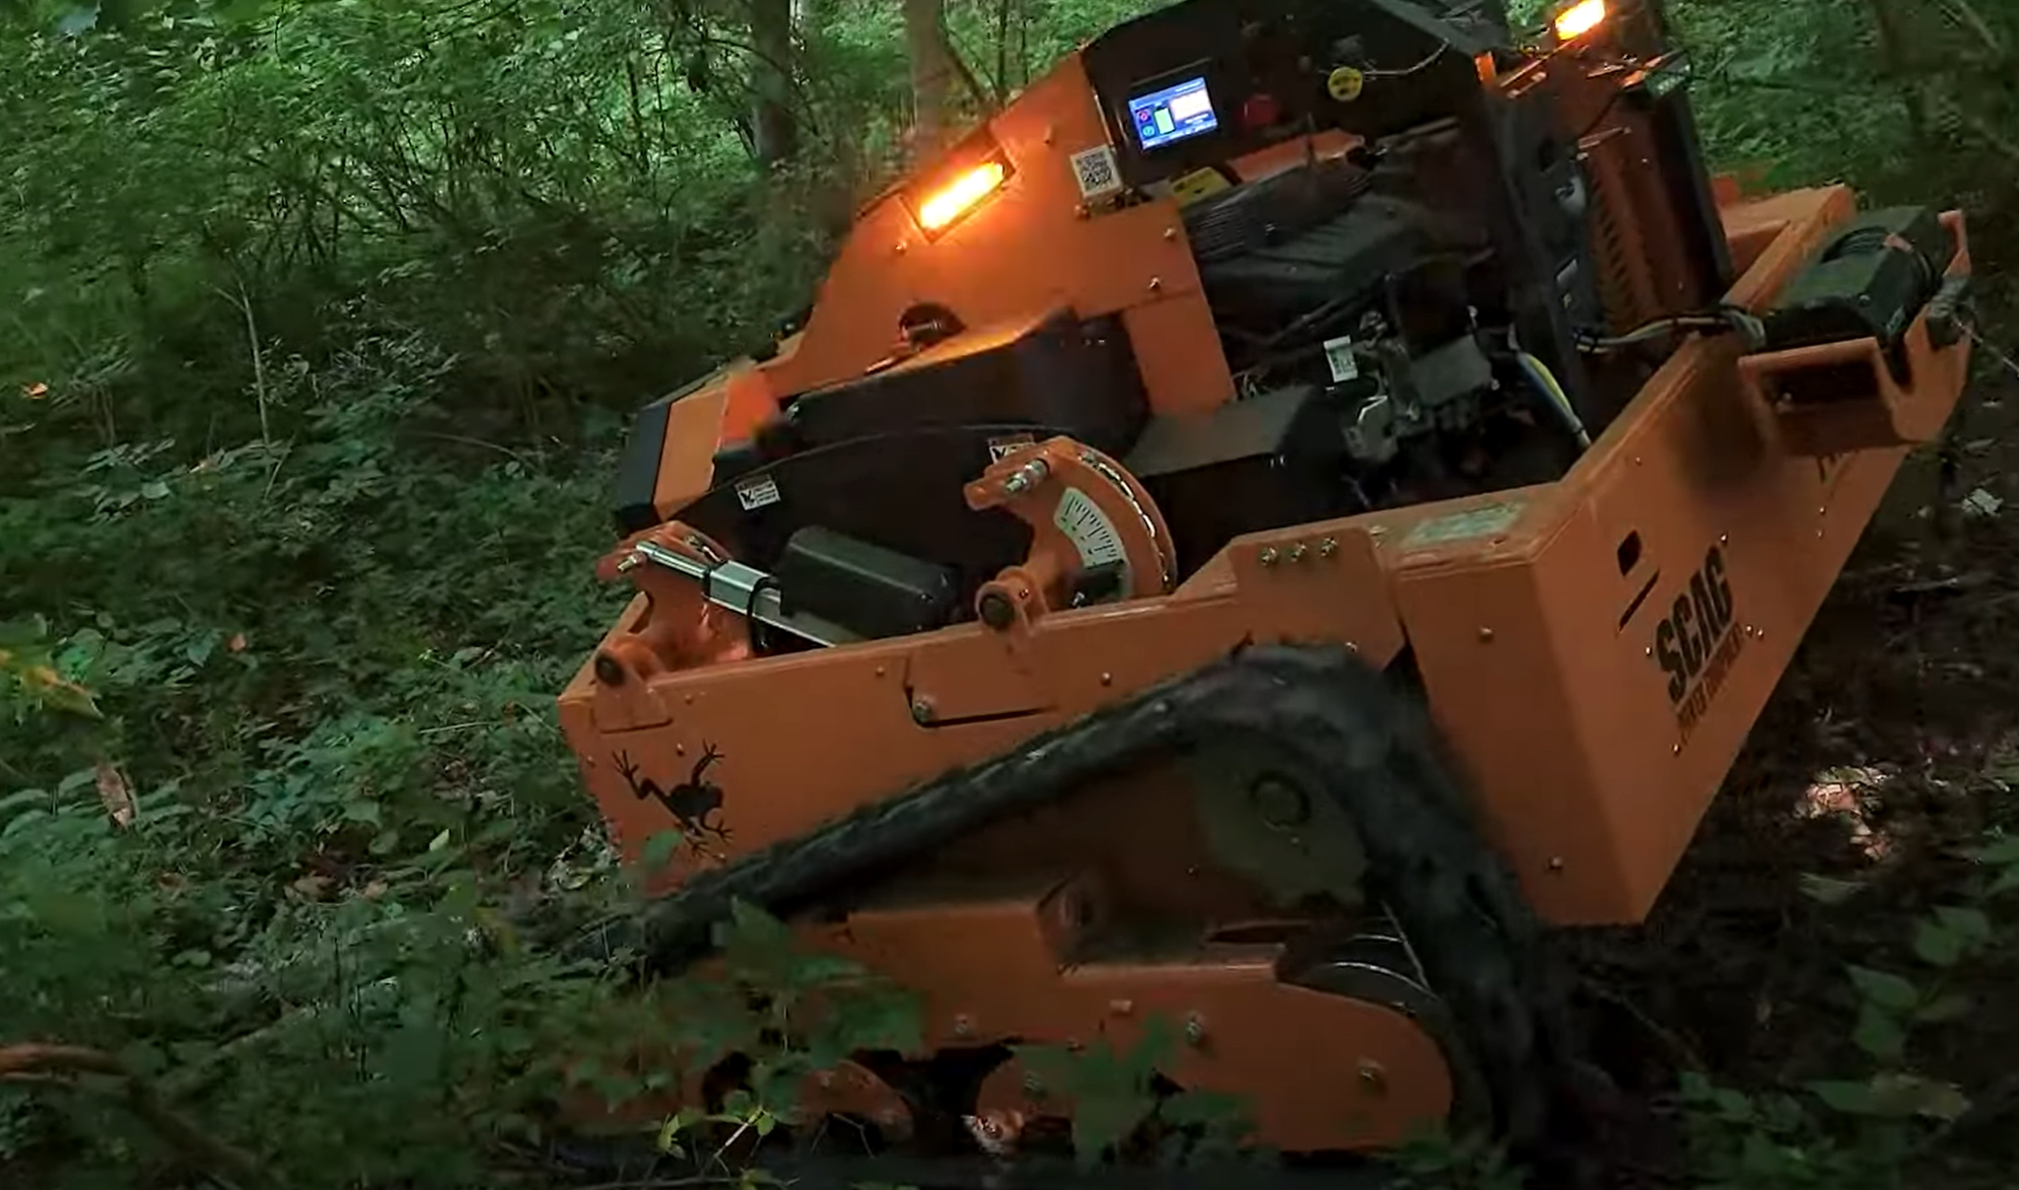
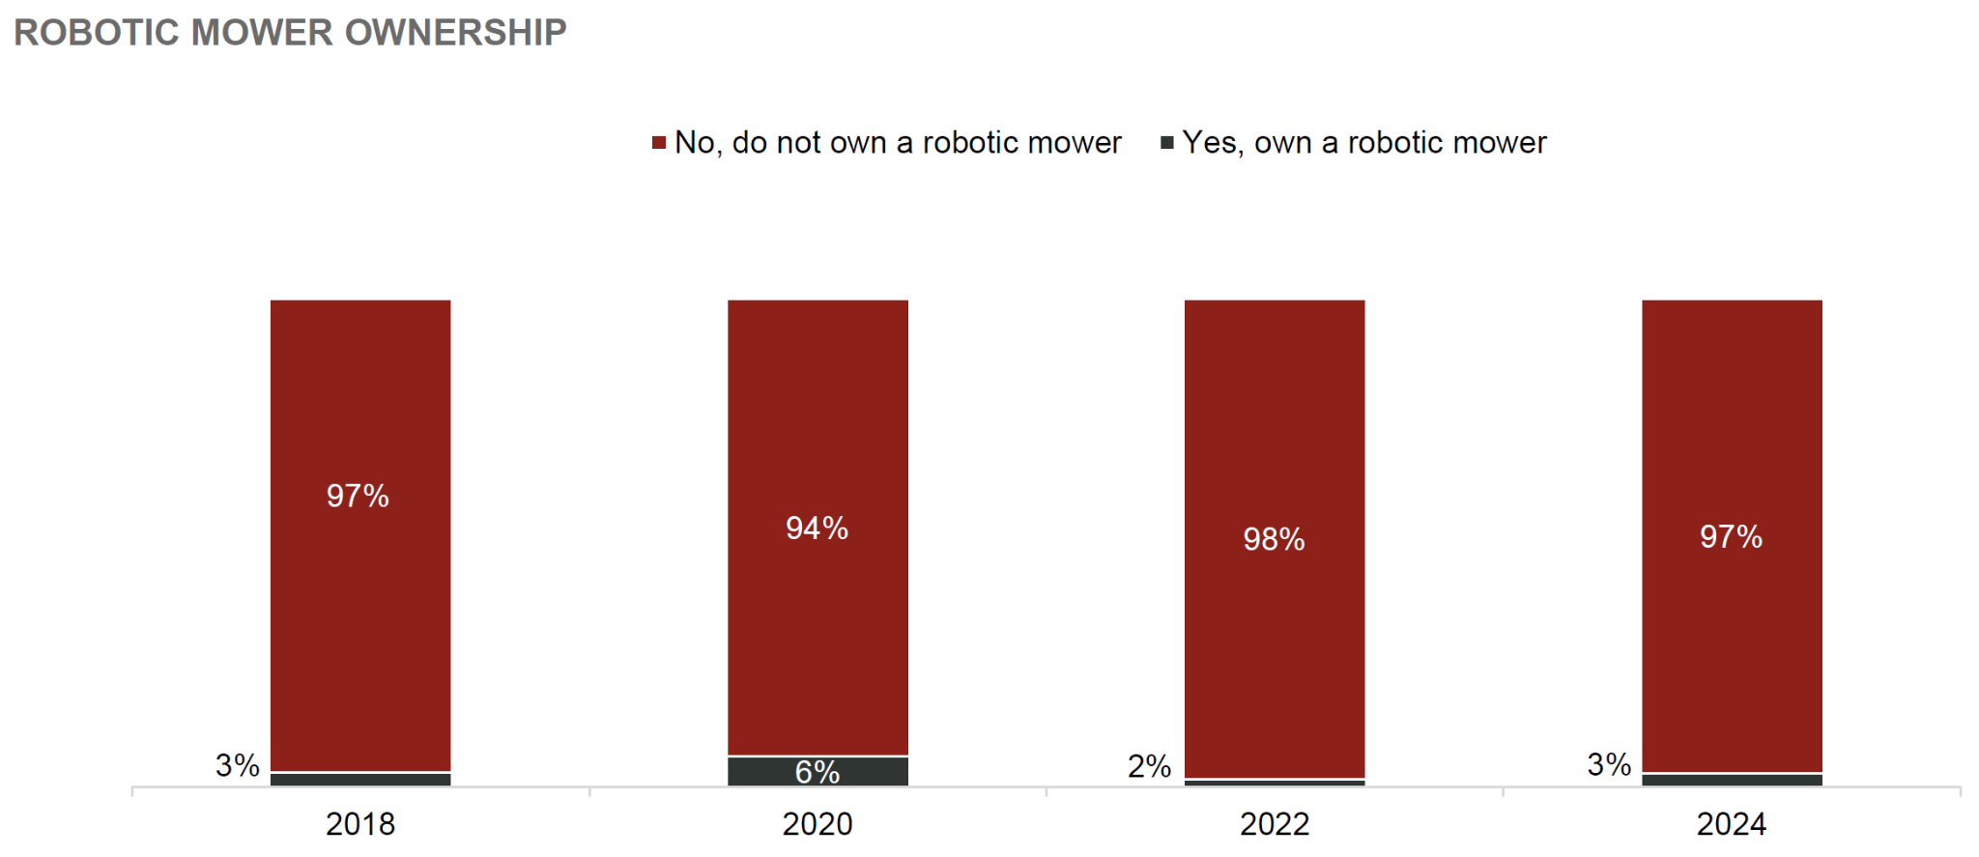
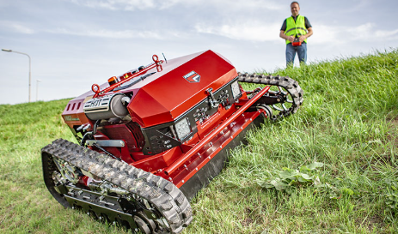
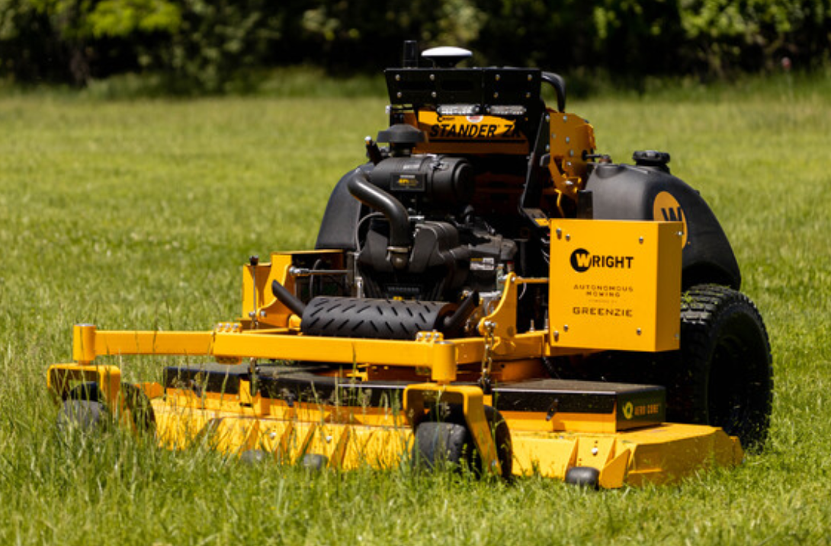
TECHNOLOGY
Hybrid / Autonomous may come before battery.
SCAG - TREE FROG
Hybrid 40HP / 9kWh, Remote Control up to 45 deg
Consumer Robotic mowers continue to grow slowly,even with increased awareness and trial
Farnsworth - OPEI Forum, Oct 2024
Commercial Benefits:
Remote Control - Operator Safety
Autonomous Programming - Crew efficiency
(29% of landscapers say labor #1 pressing concern)
Hybrid Rationale:
Lower center of gravity, range extension
Allows OEMs to refine technology to bridge the gap between battery and gas
FERRIS - FRC7
Hybrid 23HP EFI / 48V e-Drive, Remote Control up to 55 deg
WRIGHT - ZK
Autonomous Stander 40HP, Programmable via Greenzie

Slide 13


TECHNOLOGY
Servicing battery-powered equipment is different.
With our service tool (same tool used on engines), can determine if battery is safe to return via normal freight
Call center manages and authorizes return
Replacement shipped to dealer with documentation and packaging, no hazmat needed
OR
If deemed damaged, we coordinate fireproof container to ship straight to recycler
Batteries come back to refurbisher
If battery deemed unfit for refurbishment, sent to recycling partner

Slide 14


TECHNOLOGY
A.I. and Connected Products will impact our categories.
Power Assist™
New tool for Briggs Servicing Dealer
Input that has been indexed:
Illustrated Parts Lists
Operators Manuals
Marketing Materials
Training Documents
Benefits to the Dealer & User
Enables consumer to be more educated when they approach the counter
Provides rookie counter staff a
powerful tool and insight
Prompts the user to consider
ancillary purchases
Positions dealerships as innovative and customer oriented
Ways AI can improve the Outdoor Power Equipment (OPE) market:
Prevent Breakdowns – AI predicts when equipment needs maintenance, reducing downtime and repair costs.
Better Inventory & Supply Planning – AI forecasts demand based on weather and sales trends, ensuring the right products are available.
Smarter Customer Support – AI chatbots assist with troubleshooting, product recommendations, and maintenance reminders.
Improved Fuel & Battery Life – AI optimizes engine performance and battery usage, making equipment last longer and run more efficiently.
Source: Ask Gemini AI (Google)

Slide 15

©2025 Briggs & Stratton. Proprietary and Confidential.
Notes:
On the screen as people enter

Slide 16
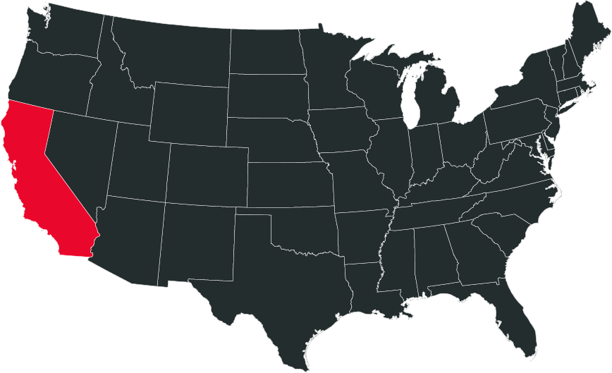


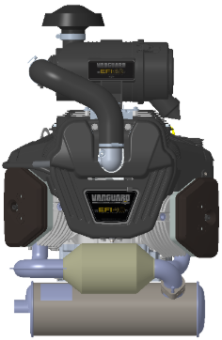
REGULATIONS
The emissions regulation environment.
1/6/25:
EPA WAIVER GRANTED
2/1/25:
“PETITION FOR REVIEW”
FILED BY OPEI TO EPA
2025:
ENGINES WITH ‘25 EO’S OK TO SELL
1/1/26:
CA ENFORCEMENT BEGINS
EPA = CA + ~7 YEARS
EARLIEST EXPECTED
EPA ACTION
2034
OTHER
STATES
EMBRACING REGS
RESISTING REGS
ENGINE SERVICE & REPLACEMENT
WARRANTY / REPAIR
Business as usual
REPLACEMENT for >225cc ENGINES
49-state engines may be used in CA for EO engine replacement (with tracking and evidence)
FUTURE COMPLIANCE
Briggs Product and Engineering is
actively pursuing anticipated Emission Reduction
Anticipate 80% Reduction: 0.8 - 3.0g/kw-hr
PRODUCT IN
DEVELOPMENT

Slide 17




REGULATIONS
Trade policy.
Key Takeaways
Known Updates
Steel & Aluminum tariff effective March 12th
All previous exemptions removed
US gets >50% of aluminum from Canada
In Discussion
Tariff application to fabricated parts
CAN & MEX delay
Reciprocal tariffs expected early April
Additional tariffs possible early April
  Automobiles
  Pharmaceuticals
  Computer Chips
2024
TODAY
NO exemptions
???
0% 7.5% 25% | 10% 17.5% 35% | 10% 17.5% 35%
0% | 0% | 25%
0% | 0% | 25%
25% with exemptions | 25% | 25%
Global Steel
& Aluminum

Slide 18
WRAP-UP
Key takeaways
Industry has largely recovered from pandemic boom/ bust, remains strong and is poised for growth
But Industry is ever changing. Consolidation, Regulation and Trade Policy may be disruptive near term and those poised to respond will win
ICE Engines (and related service revenue) are not dead; anticipate return to growth as battery adoption slower than expectations and no new emission regulations on the near term horizon
Innovation is centered on productivity and solving customer problems with increasing investment in Hybrid, Autonomous and AI/ Connected Products

