Slide 1
Trump 2.0
Chief Government Relations Officer
Brian Wild

Slide 3
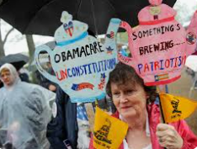
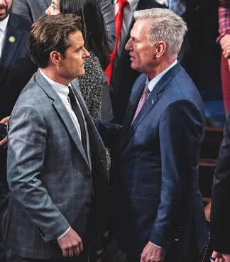
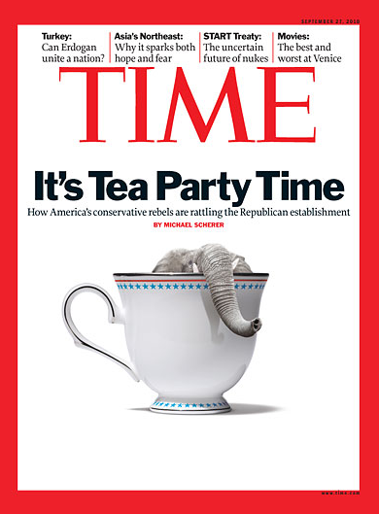
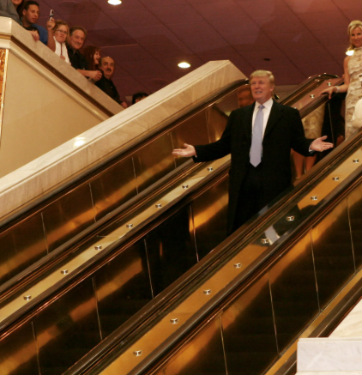
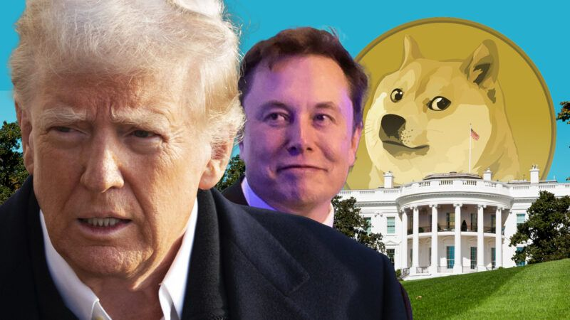
2010 2015 2021 2024
Process vs. Policy
Process Vs. Policy

Slide 4
Trump Decision Tree
PARADIGM SHIFT –
A major change in the worldview of how something works or is accomplished
TRANSPARENCY –
The public disclosure of information that enables people to hold decision-makers to account
Russ Vought – Stephen Miller

Slide 5
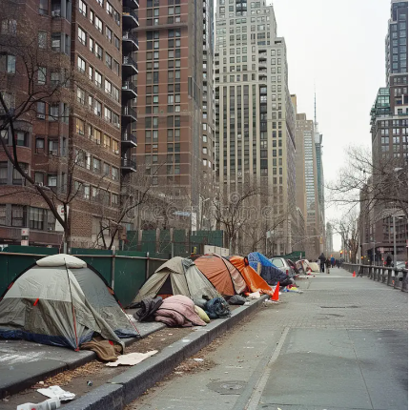
Election Themes are Policy Themes
Economy Pocket Book, Pro-Worker
Safety Immigration, Police, Bathrooms
Economic Security National Security, Imperialism
Nationalism US Dominance

Slide 6
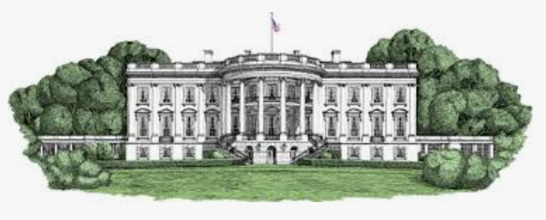
TRUMP 2.0
Remembering
and Remodeling
the
WHITE HOUSE
Accessible
Transactional
Gas vs. Brakes
Mistakes are forgotten
Friends list

Slide 7
Explaining the Trump Tariffs
Negotiating Tool - Distributive vs. Integrative
Foreign Policy - Economic Security is National Security
Revenue Raiser

Slide 8
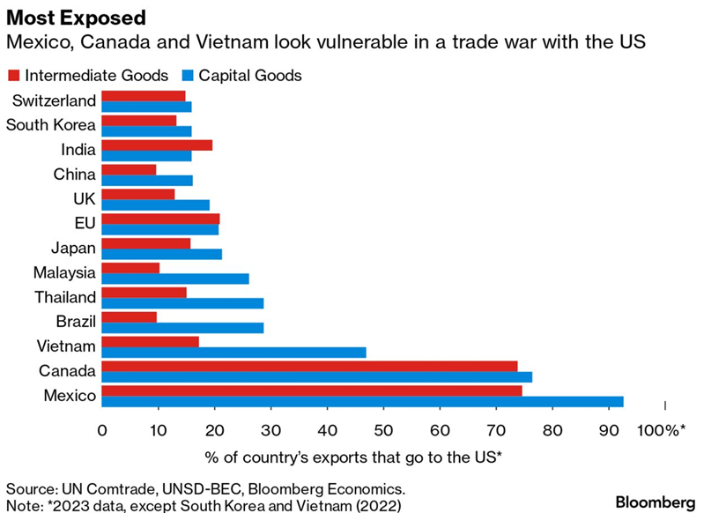
Key Issue:
Winning

Slide 9
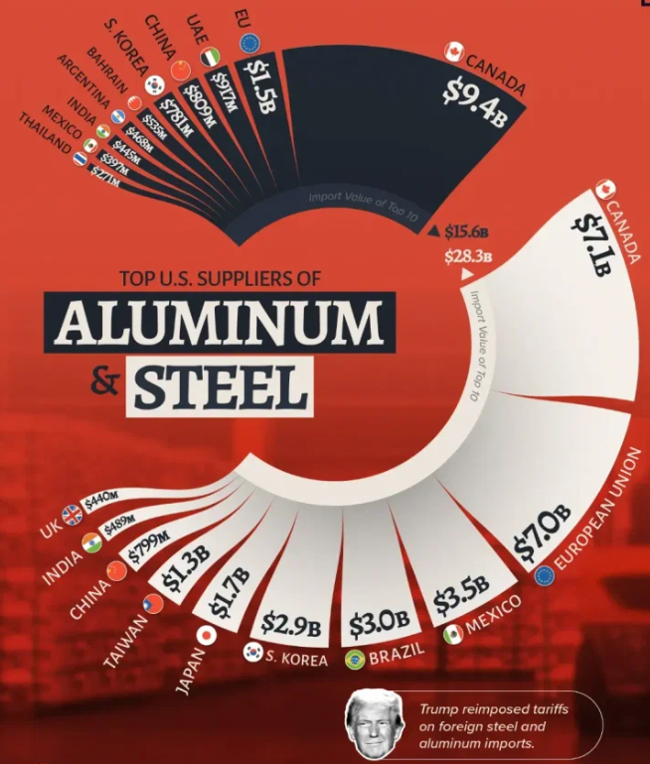
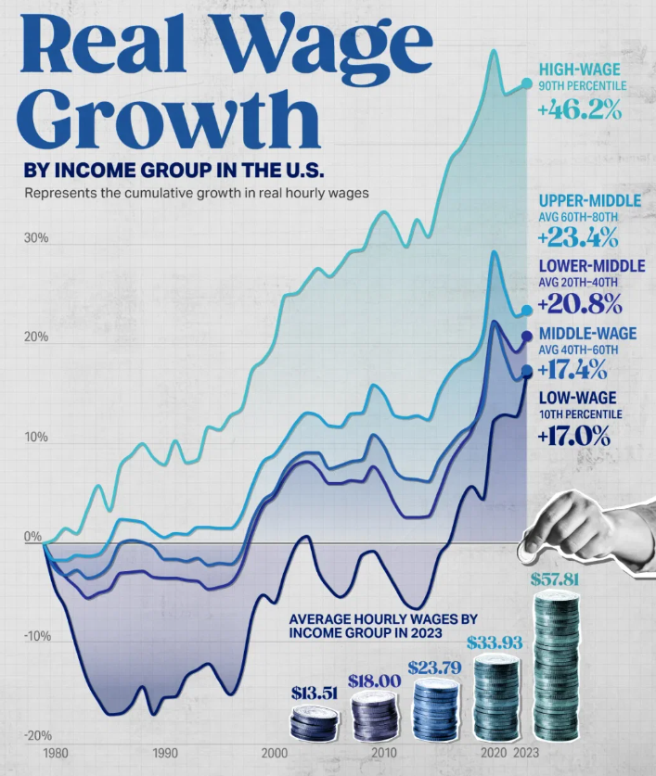
Tariffs and Wages

Slide 10
NAW Messaging
Tight Margins
Any increase in tariffs will be inflationary to the US consumer.
Cash Flow/Capital Concerns
Threats force company behavior
Economic Growth will suffer amplifying debt and
Supply chain disruption
Allies matter
Tariffs threaten:
Inflation
Growth
Debt
National Security

Slide 11
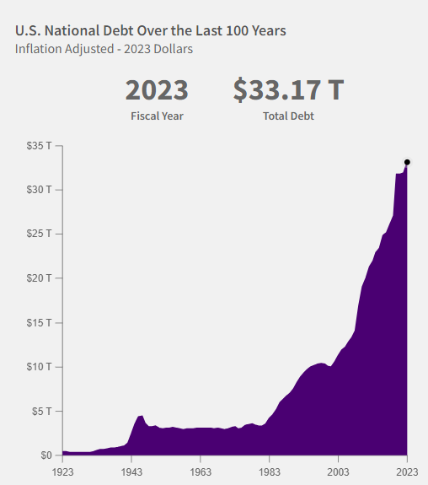
Key Issue:
TAXES
Economic Security
Pro-worker
Revenue
VS.

Slide 12
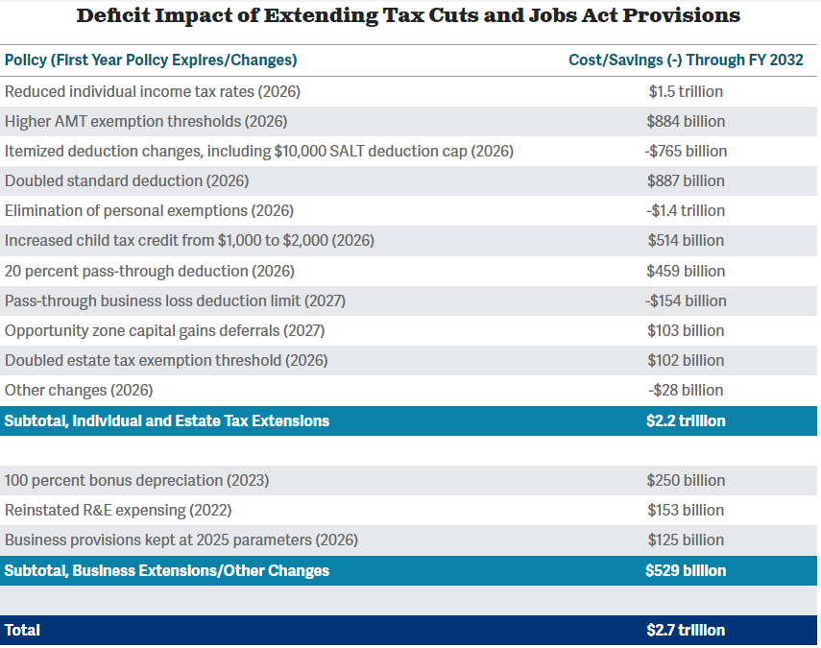
TAXES

Slide 13
ADJUSTING THE DIALS
199A – Small business deduction
SALT vs. corporate Salt
LIFO
Estate tax
Surtax on non-US companies
Tariffs
Capital Gains
Carried Interest
Overtime Pay
Taxes on Tips
GILTI – international taxes

Slide 14
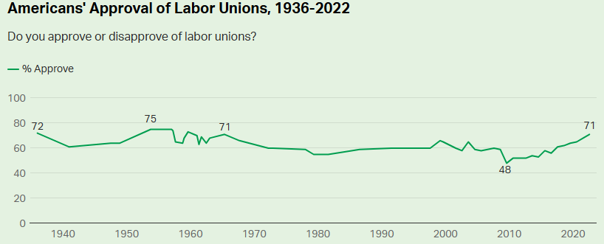
WAREHOUSE Issues
Warehouse Worker Protection Act
EMD Sales, Inc. V. Carerra
LIFO
Supply Chain
Warehouse Zoning
Heat Rule
NATIONAL ASSOCIATION OF WHOLESALER-DISTRIBUTORS (NAW)
14

Slide 15
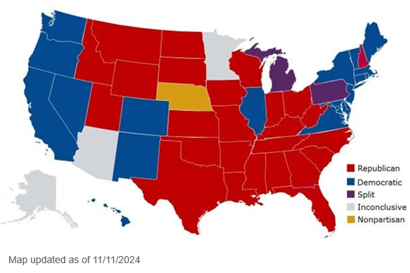
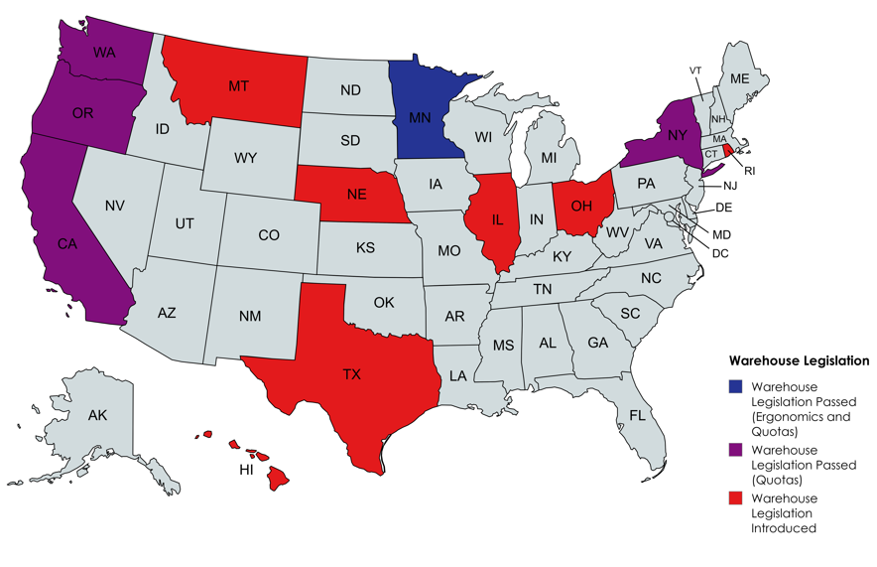
STATES
Policy moves to places of least resistance
Notes:
Vacancies – McCarthy and Santos

Slide 16
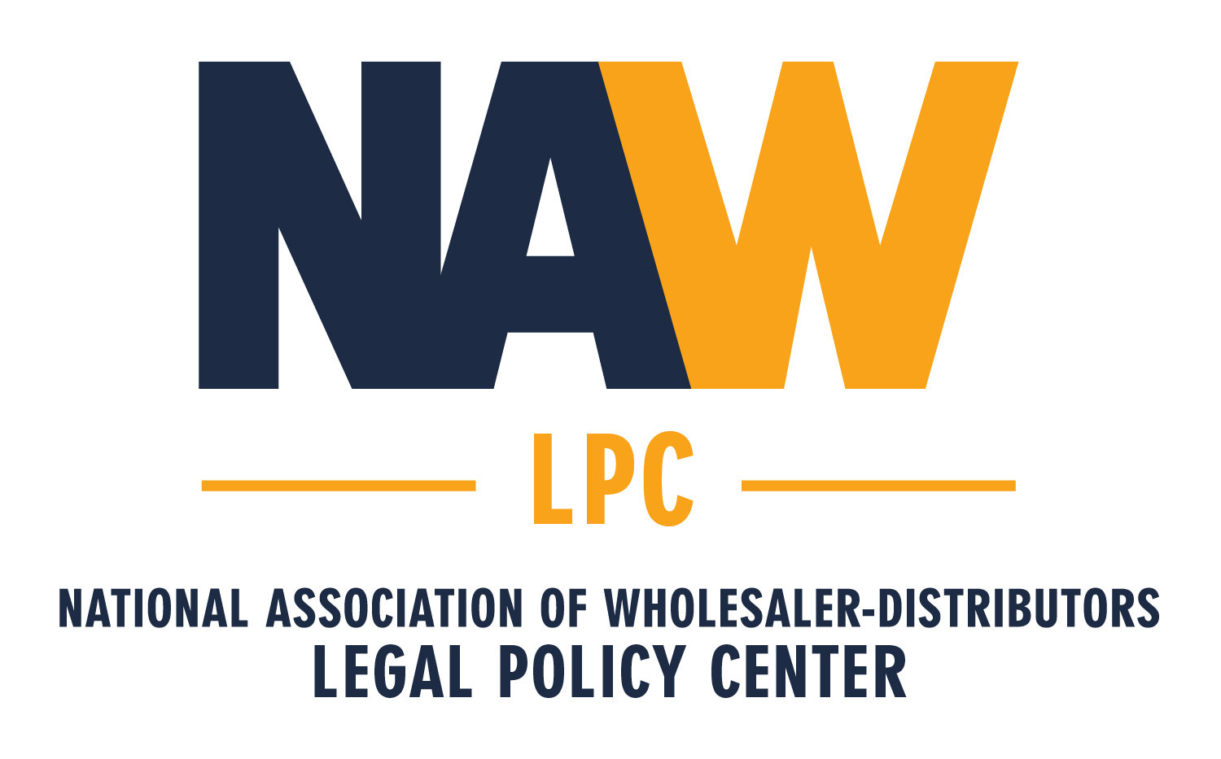
The voice of the wholesale distribution industry in precedent-setting litigation in courts across the country defending the free enterprise system. The Center also serves as a key legal resource for NAW members, helping them navigate the regulations and laws that impact their business.
The NAW Legal Policy Center
Fights to defend free enterprise
Challenges federal and state regulatory actions that impact the wholesale distribution community
Drafts amicus briefs in precedent-setting cases
Serves as a key legal resource for NAW members

Slide 17
NAW as Plaintiff
NAW as Amicus (“Friend of the Court”)
Department of Labor Overtime Rule
NAW argues that DOL exceeded its authority under the FLSA, and the rule is arbitrary and capricious under the Administrative Procedure Act.
Status: The case has been consolidated with a challenge to the rule brought by the State of Texas, State of Texas v. U.S. Department of Labor.
OSHA Worker Walkaround Rule
NAW argues that the rule exceeds OSHA’s statutory authority under the Occupational Safety and Health Act, is an unconstitutional taking of private property, and is arbitrary and capricious in violation of the Administrative Procedure Act.
Status: Parties are currently finishing briefing the case. No hearing scheduled
Challenge to NLRB Claim of Special Deference When Asking for Injunctive Relief Starbucks Corp. v McKinney,
Status: VICTORY; June 13, 2024 decision.
Challenge to FTC Non-Compete Rule Ryan, LLC, et al., vs Federal Trade Commission a federal district court in Texas stopped FTC’s non-compete rule from taking effect.
Status: VICTORY, August 20, 2024.
Political Protests by Employees in a Workplace In Home Depot USA Inc. vs. NLRB
Status: Awaiting oral argument.
NLRB Decision Permitting Expanded Use of Card Check In Cemex Construction Materials Pacific, Inc. v. NLRB challenging a recent NLRB decision that makes union authorization cards – rather than secret ballot elections
Status: Awaiting oral argument.
Protecting Outside Sales and Other Fair Labor Standards Act (FLSA) Overtime Exemptions In EMD Sales, Inc. v. Carerra,
Status: Oral argument scheduled for November 5, 2024
Challenging Securities and Exchange Commission (SEC) Climate-Risk Disclosures Rule
In State of Iowa v. SEC
Status: Petitioners reply brief is due September 2. No oral argument date has been set.

Slide 18
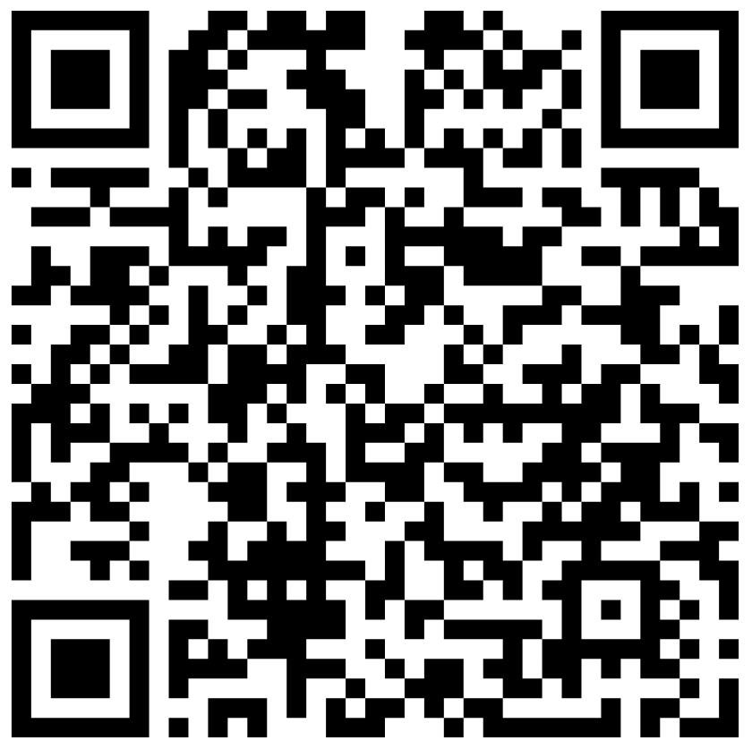
Supporting NAW’s Litigation & Policy Fund
Protect Your Business,
Strengthen Our Industry
Help NAW to engage in high-impact legal and policy initiatives, including the Legal Policy Center. Corporate funds are accepted.
Or Visit
www.NAW.org/donate
Any and all companies are allowed to contribute. Both personal and corporate contributions accepted.

